Slide 1
RECAP

Slide 2
Data Viz-Definition
Visualisation as a discovery tool(Anscombe’s Quartet)
Visualisation Objectives

Slide 3
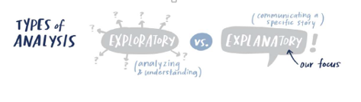
Car Manufacturer
DressMart Inc.
Article from NewYork Times
EDA on IRIS Data

Slide 4
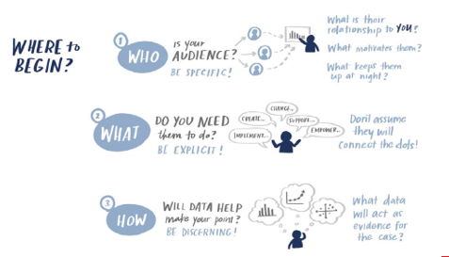
Visualisation Context
CASE Study
Summer Learning Programme
Clothing Retailer
DSE Electives
CANVAS
Higher Education
People Analyst

Slide 5
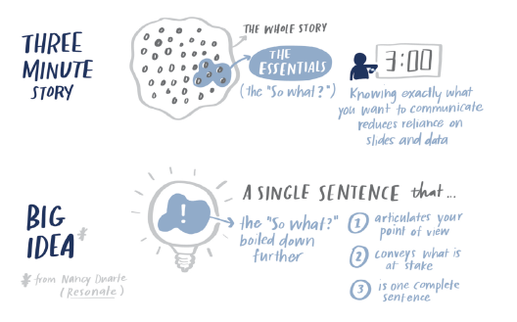

Slide 6
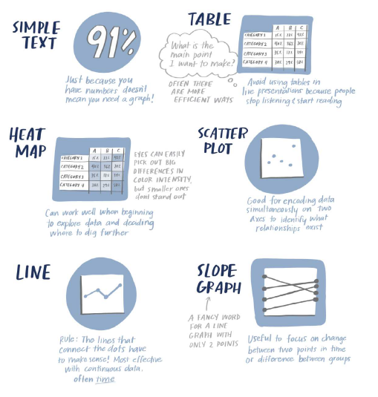
Types of Visuals

Slide 7
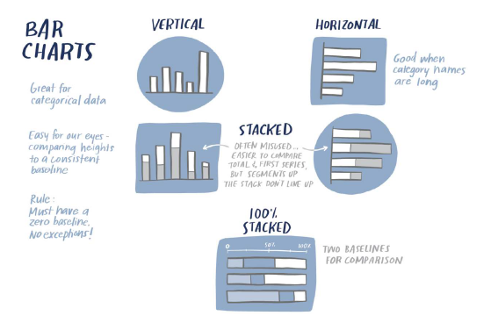
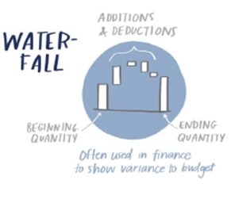
Types of Visuals
CASE Study
Summer Learning Programme
New Client Tier Share
Corporate Giving Programme(Canvas)
Capacity and Demand (Canvas)
Attrition rate(Canvas)
Graphs to be avoided

Slide 8

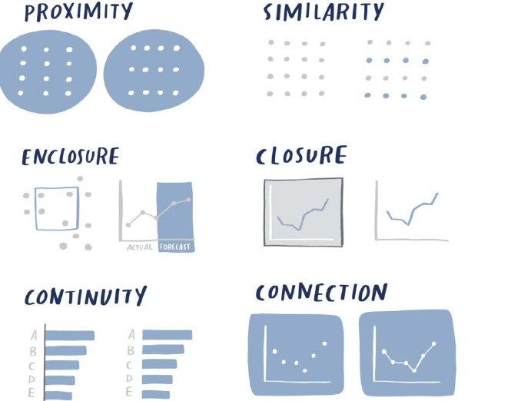
Visual Perception

Slide 9
Decluttering
USDA
Tickets Received an Processed
Demand and Capacity

Slide 10
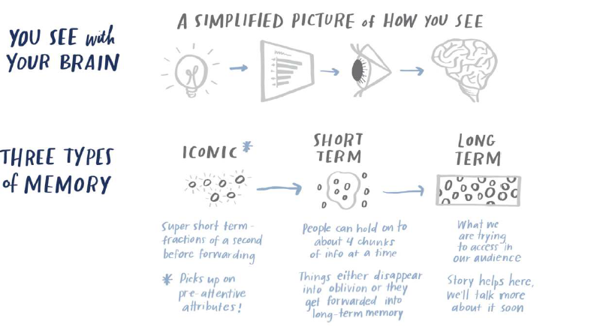
Preattentive Attributes

Slide 11
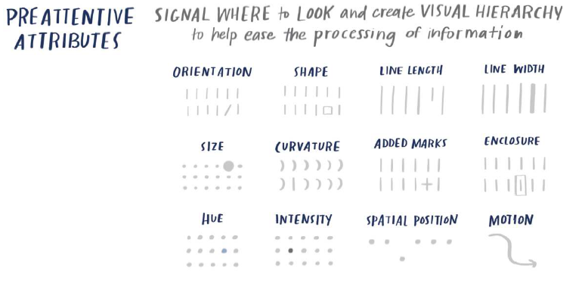
Pre attentive Attributes

Slide 12
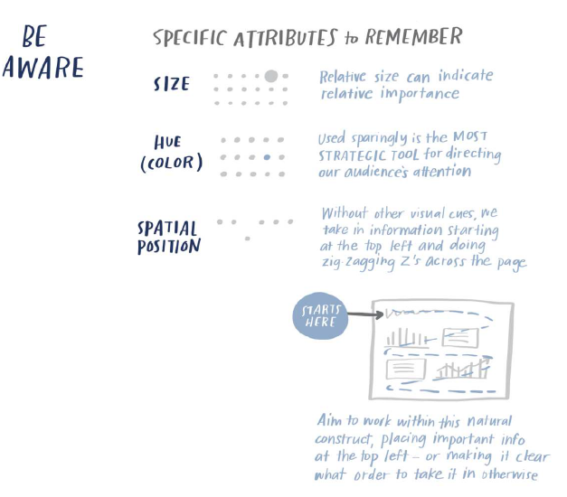
Pre attentive Attributes

Slide 13
Tableau Desktop Concepts: Intro

Slide 14
Tableau Desktop Concepts
Exhibit-1
The large selection of products comprises three main categories: office supplies (e.g., staples), furniture (e.g., chairs), and technology (e.g., smartphones)

Slide 15
Tableau Desktop Concepts
Exhibit-2
Global Superstore’s largest demand comes from the U.S., Australia, China, France, and Germany. We want to know the breakdown of sales by geography. For instance, is the United States more profitable than China for Global Superstore?

Slide 16
Tableau Desktop Concepts
Exhibit-3
As for their sales revenue, it surpassed $4 million in 2014, a 26% increase from 2013
Exhibit-4
Global Superstore’s order volume experienced a healthy growth; with more than 17,000 orders processed in 2014

Slide 17
Tableau Desktop Concepts: Answering Business Questions with Tableau.
Compare the frequency of the different shipping modes across the different order priorities.
Investigate the market wise sales
Sales and profit across different segments.
Analyse the monthly sales of subcategories for the year 2014

Slide 18
Different Chart Types
Table Calculations
Problem Solving Using Tableau

Slide 19
Visual Analytics
UNDERSTANDING DESCRIPTIVE STATISTICS
Summary Card
SETS
Reference Objects
Box Plots
Confidence Interval

Slide 20
Visual Analytics
Trend Lines
Forecast
Cluster

Slide 21
SWD:End to End Case Study

Slide 22
Dashboard Concepts

Slide 23
Dashboards and Stories in Tableau

Slide 24
Tableau Problem Solving

Slide 25
MATPLOTLIB
Complete Example-EDA

Slide 26
SEABORN
Relplots
Distplots
Categorical Plots
Regression Plots
MAPS-FOLIUM

